Slide 1
All-Pairs Shortest Paths
Here we consider the problem of finding shortest paths between all pairs of vertices in a graph.
we are given a weighted, directed graph G = (V, E) with a weight function w : E → R that maps edges to real-valued weights.
We wish to find, for every pair of vertices u, v ∈ V, a shortest (least-weight) path from u to v, where the weight of a path is the sum of the weights of its constituent edges.
We typically want the output in tabular form: the entry in u’s row and v’s column should be the weight of a shortest path from u to v.

Slide 2
If we solve problem using Single-Source Shortest Paths algorithm
We can solve an all-pairs shortest-paths problem by running a single-source shortest-paths algorithm |V| times, once for each vertex as the source.
If we use Dijkstra’s algorithm(if edge weights are nonnegative) we have running time running time of O(V E lg V).
If we use Bellman-Ford algorithm(Negative edge weights are allowed ) the resulting running time is O(V²E).

Slide 3
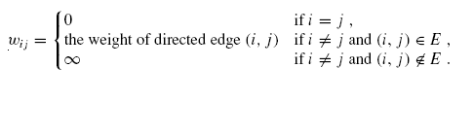
Assumption for algorithm
This algorithm uses an adjacency-matrix representation of the graph.
For convenience, we assume that the vertices are numbered 1, 2, . . . , |V|, so that the input is an n × n matrix W representing the edge weights of an n-vertex directed graph G = (V, E).
That is, W = (wi j ), where

Slide 4
Assumption for algorithm
Negative-weight edges are allowed, but we assume for the time being that the input graph contains no negative-weight cycles.
The tabular output of the algorithms presented is an n × n matrix D = (d_{i j} ), where entry d_{i j} contains the weight of a shortest path from vertex i to vertex j .
That is, if we let δ(i, j ) denote the shortest path weight from vertex i to vertex j, then d_{i j} = δ(i, j ) at termination.

Slide 5
Assumption for algorithm: predecessor matrix
Here we also need a predecessor matrix Π= (π_{i j} ).
Where π_{i j} is NIL if either i = j or there is no path from i to j .
Otherwise π_{i j} is the predecessor of j on some shortest path from i.
To print shortest path from vertex i to vertex j we can use following procedure PRINT-ALL-PAIRS-SHORTEST-PATH.

Slide 6
PRINT-ALL-PAIRS-SHORTEST-PATH.
PRINT-ALL-PAIRS-SHORTEST-PATH(Π, i, j )
1 if i = j
2 then print i
3 else if π_{i j} = NIL
4 then print “no path from” i “to” j “exists”
5 else PRINT-ALL-PAIRS-SHORTEST-PATH(Π, i, π_{i j} )
6 print j

Slide 7
The Floyd-Warshall algorithm
Things to remember
Let d _{i j} ^{(k)} be the weight of a shortest path from vertex i to vertex j for which all intermediate vertices are in the set {1, 2, . . . , k}.
When k = 0, a path from vertex i to vertex j with no intermediate vertex numbered higher than 0 has no intermediate vertices at all.
Such a path has at most one edge, and
hence d _{i j} ⁽⁰⁾ = wi j .

Slide 8
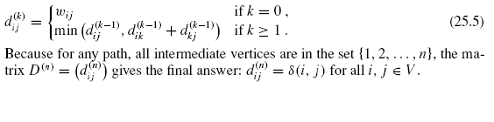
The Floyd-Warshall algorithm(recursive definition)
A recursive definition following the above discussion is given by

Slide 9
The Floyd-Warshall algorithm(Solution in bottom up manner)
Based on recurrence (25.5), the following bottom-up procedure can be used to compute the values d _{i j} ^{(k)} in order of increasing values of k.
Its input is an n × n matrix W defined as in equation (slide 3). The procedure returns the matrix D(n) of shortest-path weights.

Slide 10
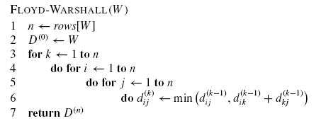
The Floyd-Warshall algorithm

Slide 11
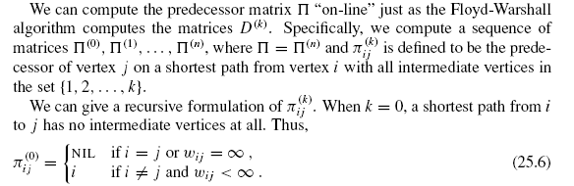
Constructing the shortest path

Slide 12
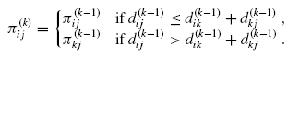
Constructing the shortest path
For k ≥ 1,

Slide 13
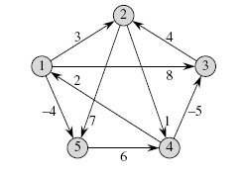
Example

Slide 14
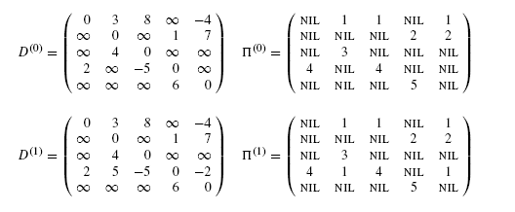
Example

Slide 15
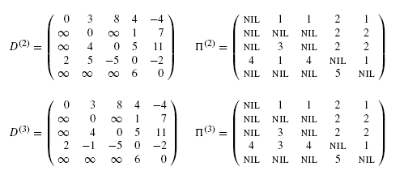
Example

Slide 16
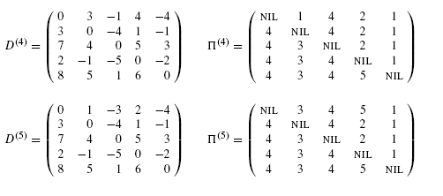
Example

